Slide 1
Fast Track Due Diligence for Covid19 Crisis Response
To respond to Covid19 emergency, UNDP is operating in a high-risk context which requires strong risk management to enable acceptance of higher risks when engaging with private sector. The following applies for short-term engagements with the private sector designed to directly respond to the Covid19 emergency.
  Level of Due Diligence:
  Minimum screening required to inform decision making includes completing only the Background Information and Step 1 Exclusionary Criteria sections of the Risk Assessment Tool.
  Initiating Units are also encouraged to screen for significant controversies (Step 2) to inform decision making. If not, this can be differed to the monitoring and risk management phase.
  Decision Making:
    No exclusionary criteria triggered → decision made locally
    No exclusionary & high-risk sector → local decision in consultation with RBx
    Exclusionary criteria triggered → escalate decision to RBx Director
    Escalation does not automatically activate the PSDD Committee for review
    For Covid19 global or regional partnerships the decision by relevant bureau should include a clause that allows COs to pursue engagement with the private sector entity without additional steps required, conditional on clearance by the RR.
    Risk Management Requirements:
      Screening of controversies during monitoring and risk management phase
      Adopt risk mitigation plan, including communication disclaimers of non-endorsement and regulated UNDP logo use
      Regular monitoring of partner during engagement

Slide 2
Fast Track Due Diligence for Covid19 Crisis Response
Operational Guidance
Consult the Guidelines when completing the Risk Assessment
See here how to access Intelligence Reports for large multinationals approved risk assessment tools should be uploaded in the dedicated COVID19 MS Teams space
Access here past cases with examples of risk management and monitoring plans
Connect with RBx Partnership Specialists and BERA Regional Partnership Advisors to get guidance and/or discuss needs of support to conduct risk assessments
Proactive risk assessments for select companies will be conducted at HQ to inform regular decision making
Mapping and Planning
Operational/Legal issues

Slide 3
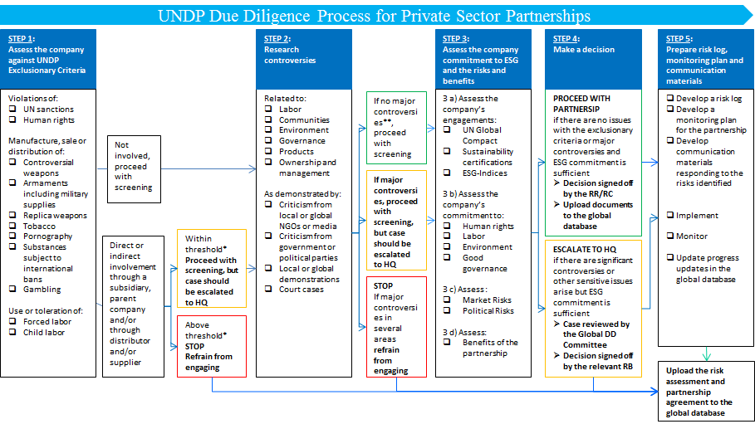
Fast Track Due Diligence for Covid19 Crisis Response
Required Upfront
Encouraged Upfront or Differed
Notes:
Exclusionary Criteria:
UNDP has defined a set of exclusionary criteria outlining those business practices considered unacceptable to the organization.
Manufacture, sale or distribution of controversial weapons, armaments, including military supplies and equipment.
Manufacture, sale or distribution of tobacco or tobacco products.
Violations of UN sanctions and the relevant conventions, treaties, and resolutions, and inclusion in UN ineligibility lists or UNDP vendor sanctions list.
Involvement in the manufacture, sale and distribution of pornography.
Gambling including casinos, betting etc. (excluding lotteries with charitable objectives).
Violation of human rights or complicity in human rights violations.
Use or toleration of forced or compulsory labor.
Controversies
Relating to Labor, Governance, Environment, Community Engagement, Ownership or Management, Product Related. Evidence of criticism (e.g. by NGOs / media, public events, governmental agencies, political parties) or relevant legal case in process. Understand their impact, recurrence and response of the entity as well as the risk they pose for UNDP
High Risk Sectors
Oil and gas
Metal and mining
Utilities
Large infrastructure
Agriculture and fishing
Timber, pulp and paper
Alcohol
Chemicals (including pharmaceuticals)
Clothing, toys and consumer electronics
Fast food, high sugar drinks and soda

Slide 4

Co-Branding in COVID19 Response Initiatives
UNDP logo may be used in the context of COVID-19 response initiatives with the disclaimer below:
“The use of the UNDP’s name or emblem or any abbreviation thereof in this [type of initiative e.g. case study or posting] does not imply that UNDP endorses “company name’ (or its affiliates) or any of “company name” (or its affiliates’) products or services.”
Logo options can be found here

